Slide 1
ARTAS iX Under the Microscope
Not Medical Advice. The information contained in this presentation is for educational purposes only and is not intended to be a substitute for professional medical advice, diagnosis or treatment. Venus Concept, Inc. is not a medical health provider and it is not holding itself out to be in any capacity. Venus Concept, Inc. is not providing health care or medical services or attempting to diagnose, treat or cure in any manner whatsoever any disease of the human body. This presentation is the intellectual property of Venus Concept, Inc. Using this material without written permission is prohibited – Venus Concept, Inc. retains all rights. There is no implied warranty to readers. You agree to hold harmless and indemnify Venus Concept, Inc. in perpetuity regarding any information provided to you from this presentation and any ancillary or collateral information contained herein or referenced to.
Notes:
Welcome to the Venus Academy module, Under the Microscope.
The information contained in this presentation is for educational purposes only and is not intended to be a substitute for professional medical advice, diagnosis or treatment. The guidelines contained within this presentation are based on current product design and use. The purpose of this course is to review technology, treatments & techniques, and to provide guidelines for the safe and efficacious use of venus concept devices.

Slide 2
Training Objectives
Understand how to identify a quality graft under the microscope
Consistently identify poor graft quality and understand the proper parameter adjustments to correct
Notes:
In this training module we will review what you will see under the microscope. This will include:
Understand how to identify a quality graft under the microscope
Consistently identify poor graft quality and understand the proper parameter adjustments to correct

Slide 3
Microscope Station Basic Set-up
Microscope
Saline Bottle
Petri Dish & Cooler
Blades
Forceps
Counting Sheet
and Pen
Cutting Board
Notes:
It is important to have everything prepared for the technician at the microscope station. The supplies you will need should be readily available before harvesting begins. You will need:
A saline filled spray bottle to keep the grafts hydrated
a petri-dish filled with a graft holding solution with graft coolers to keep the grafts at the ideal temperature
Straight or angled forceps –based on preference
cutting boards – a tongue depressor or clear view board, also based on personal preference
blades for trimming and
counting sheet to keep track of how many grafts you have.

Slide 4
Microscope User
Adjust chair for personal ergonomics, posture and hands
Adjust microscope settings for focus and less eye strain
Make sure to use all required PPE
Make sure to have all items needed for productivity and efficiency
Notes:
The Microscope station should be set up by the user due to personal preference. The clinician should be comfortably seated in front of the microscope with all of the required PPE and all supplies discussed previously needed for productivity. Adjust microscope setting for your eyes to reduce eye strain as well as lighting. Adjust the chair for personal ergonomics, efficiency and productivity.

Slide 5
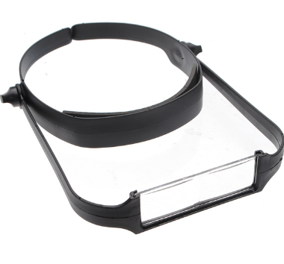
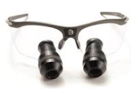
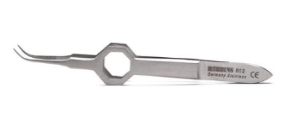
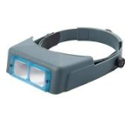
2 Vital Instruments for Extraction
Forester Forceps – A set of 2 curved, serrated are best for 2 handed extraction technique
Loupes enlarge the appearance of
grafts for a proper extraction
Notes:
There are 2 vital instruments the clinician extracting the grafts will need - and two curved serrated forceps for proper two handed extraction technique an magnifying loupes to enlarge the appearance of grafts for proper extraction. Extraction technique is a key component to graft quality.

Slide 6
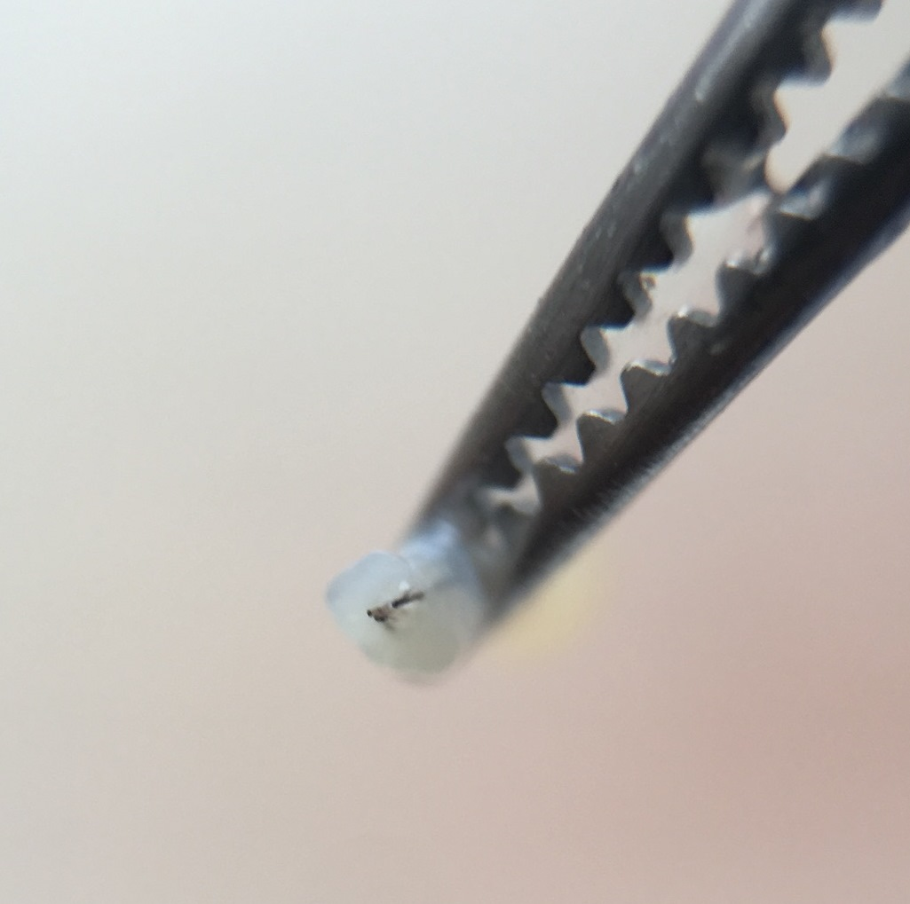
Quality Graft
Centered Hair with Circular Epidermis
Bulbs with Protective Root Sheath
Dermal Fat at Bottom of the Grafts
Notes:
It is important to understand what a good quality graft is and be able to identify good quality graft under the microscope. There are a few things to observe for good graft quality. The hair should be centered with a circular epidermis, the bulbs should have protective root sheath with tissue surrounding the grafts and there should also be some dermal fat at the bottom of the graft.

Slide 7
Follicular Units
F1
F2
F3
F4
Notes:
Follicular Units (or grafts) typically range from 1 to 4 hairs. These are referred to F1s for one hair grafts, F2s for 2 hair grafts and F#s/F4s accordingly. When examining grafts under the microscope, distinguish the difference between F1s, F2s, F3s and F4s. The grafts should be separated by groupings of hair in a quartered petri dish by the clinician. This will help you determine where the grafts will be placed in the recipient area.

Slide 8
Issue: Little to No Tissue on Bottom of Graft
What Do You See?
Bulbs Appear Stripped
Possible Causes:
Incomplete Dissection
Corrective Steps:
No Protective Root Sheath
Extraction Technique
Needle & Punch Size
Ensure use of 2-Hand Extraction Technique
Increase CD if Dissection is Incomplete
Increase ND to Increase Tissue at the Bottom
If Using a Smaller Needle/Punch Size and More Tissue is Desired, Consider Using a Larger Size Needle/Punch
OR
Notes:
We will now discuss a few issues you may come across during the harvesting procedure.
In this slide you can see there is little to no tissue at the bottom of the graft. There are a few possible causes: First it may be an incomplete dissection. An incomplete dissection is most often due to the punch not going deep enough to fully separate the soft tissue from the follicle. If the dissection was not complete increase the coring depth, complete 1-2 more harvests, and check the grafts again. Increasing the coring depth will cause the punch to go deeper, allowing for full dissection of the graft. Another cause of incomplete dissection is the needle depth. The user interface operator should observe the newtons. If the newtons are high, this may indicate the needle depth is too shallow, preventing the punch to achieving the needed depth to fully dissect the graft. If the dissection is incomplete and the newtons are high, increase the needle depth, complete 1-2 more harvests and check the graft quality.
The extraction technique is also very important. Ensure the technician is using the two handed extraction method. Not properly extracting the graft can lead to “stripping” of the tissue. Ensure the technician is using the two handed extraction method.
Finally, You may also consider the size of the needle and punch that you have installed. If you started the case with a 19 gauge needle and you notice the grafts are too thin, then you may choose to switch to an 18 gauge needle and punch to achieve better surrounding tissue.
Allow the system to harvest 5-10, next listen to the feed back from the extractor, final step examine under the microscope and take into account all information in order to make proper parameter changes. (UI should also be observing how the needle /punch are responding to skin as it harvests.)
In this particular image, increase PD, unless we see cut follicle transections. Harvest 5-10 new harvest, listen to feedback from the extractor and finally examine under the microscope for best harvest and yield.
(Tissue may also be affected by the needle size chosen)
Another reason harvests get stripped is due to poor extraction techniques. “Hand Over Hand Extraction Technique “should be used at all times.

Slide 9
Issue: Crushed, Spun and Bent Bulbs
What Do You See?
Damage to the Lower Portion of the Graft
Possible Causes:
Deep CD
Corrective Steps:
Decrease the CD
Crushed, Spun or Bent
Ensure that the Skin Tensioner is Applied Properly and Reapply if Necessary
Improper Skin Tensioner Application
Spun Bulb
Crushed Bulb
Bent Bulb
Notes:
Another issue that may be observed under the microscope is Crushed, Spun or Bent bulbs. You will see damage to the lower portion of the grafts at the bulb. Most commonly, this type of damage is caused by the rotating punch being too deep. To correct, decrease the CD to make more shallow, complete 1-2 more harvests and check the graft graft quality. Another cause may be the tensioner application. If the application is not adequate and creates a “trampoline effect, this may cause the punch to push down on the tissue causing the bottom of the follicle to to push up into the side of the punch. Always watch for proper tensioner application and reapply if necessary.

Slide 10
Issue: Caps
What Do You See?
Only Top Layer of Skin
Possible Causes:
Improper Extraction Technique
Corrective Steps:
Increase the CD, if Dissection is Incomplete
Ensure that the Skin Tensioner is Applied Properly and Reapply if Necessary
No Hair Follicles
Ensure the Proper 2-Hand Extraction Technique is Used
Incomplete Dissection
The Punch Struggles to Dissect because the Needle Depth is Too Shallow
Improper Skin Tensioner Technique
Increase ND if the Punch is Struggling to Dissect
No Hair Follicles
Present
Top Layer of Skin Only
Notes:
The next issue you may observe is capping of grafts. Caps are only the top layer of skin with no hair follicles. As with any any issue, always double check the tensioner application and reapply if necessary.
There are a few possible causes: First it may be an incomplete dissection. An incomplete dissection is most often due to the punch not going deep enough to fully separate the soft tissue from the follicle. If the dissection was not complete increase the coring depth, complete 1-2 more harvests, and check the grafts again. Increasing the coring depth will cause the punch to go deeper, allowing for full dissection of the graft.
The extraction technique is also very important. Ensure the technician is using the two handed extraction method. Not properly extracting the graft can lead to “stripping” of the tissue. Ensure the technician is using the two handed extraction method.
Finally, inf the needle depth is too shallow, the punch will struggle to complete the dissection and lead to capping of the grafts. The user interface operator should observe the newtons. If the newtons are high, this may indicate the needle depth is too shallow, preventing the punch to achieving the needed depth to fully dissect the graft. If the dissection is incomplete and the newtons are high, increase the needle depth, complete 1-2 more harvests and check the graft quality.

Slide 11
Coring Depth
Good Depth
Too Deep
Too Shallow
Full Dissection of Graft
Shoulder Pushes on Skin & Punch Bends, Crushes or Spins Bulbs
Incomplete Dissection of Graft
Notes:
Let’s discuss the coring depth in more detail so you have a better understanding of how it affects graft quality.
The ARTAS system uses a 6mm punch, meaning that the distance from the shoulder of the punch to the tip is 6mm. If you look at the first picture on the left showing a “good depth”, the punch does not have to go all the way to the shoulder to make a complete dissection. This is dependent on the patient length of their follicles.
Looking at the example in the middle, the punch is too deep. The shoulder of the punch is pushing down on the tissue causing the bulbs to be pushed up onto the edges of the punch leading to bent, crushed or spun bulbs.
The example of the right shows a punch that is too shallow. When the punch does not go deep enough, it is not able to fully separate the soft tissue from the graft. This leads to incomplete dissection causing stripping of the graft or capping.

Slide 12
Issue: Collateral Damage
What Do You See?
A Graft Showing Damage to the Neighboring Graft
Possible Causes:
Not Ideal Skin Tensioner Application
Corrective Steps:
Ensure that the Skin Tensioner is Applied Properly and Reapply if Necessary
Shallow Needle Depth
Site Spacing Too Close
Increase Needle Depth
Verify the Site Spacing is Ideal for Patient
Neighboring Graft
Targeted Graft
Notes:
Another issue you may observe is referred to as collateral damage. Here, the system targets a graft and slides into a neighboring graft resulting in damage/transections to both grafts, as seen in this image. As with any issue, always double check the tensioner application and reapply if necessary. Tension is the most common cause of this issue. If tension is poor the needle may not be able to anchor properly to the tissue and therefore slide into the graft next to the target during dissection.
If the tensioner application is adequate, another cause may be a shallow needle depth. If the needle depth is too shallow, it may not anchor to the tissue. When the punch follows behind the needle, it will slide the needle into the neighboring graft. Increase the needle depth to hold the tissue in place, complete 1-2 harvests and check the graft quality.
Finally, the spacing between harvests may be too close. If the spacing is too close, the needle and punch may slide into a previously targeted graft. To correct increase the site spacing parameter in the configuration parameters menu.

Slide 13
Issue: Fully Transected Follicles
What Do You See?
Grafts Fully Transected at the Upper Portion of the Graft
Possible Causes:
Corrective Steps:
Decrease Needle Depth
Deep Needle Depth
Ensure the Skin Tensioner Application is Ideal and Reapply if Necessary
Improper Skin Tensioner Application
Cut Follicles
Notes:
The issue you see here are fully transected, or fully cut follicles. A fully transected follicle is a follicle that is cut at the upper portion of the graft. As with any issue, always double check the tensioner application and reapply if necessary.
The most common cause of this is a needle depth setting that is too deep. To correct, decrease the needle depth, complete 1-2 harvests and check that the correction improved the graft quality.

Slide 14
Issue: Partial Transections
What Do You See?
A Graft with a Single Hair or Portion of the Group that has been Transected During Harvesting
Possible Causes:
Incorrect Approach Angle
Corrective Steps:
Examine Closely Under the Microscope to Determine Proper Adjustment of Angle
See Next Slides for More Detail
Partial Transections
Notes:
Here, we see a partial transection. A partial transection is when at least one hair is intact and the other hair, or hairs, are transected. Most commonly this is an angle issue. You will need to put the graft under the microscope and determine where the transection occured. If the hair is transected on the superior or top of the graft then the angle is coming in too high, to correct it, decrease the angle by one click, complete 1-2 harvests, and check the grafts to ensure the change improved graft quality.
If the transection in on the inferior portion of the graft then the angle is approaching too acute. To correct, increase the angle by one click. Complete 1-2 harvests and check the grafts to ensure the change improved graft quality.
Let’s expand more on this.

Slide 15
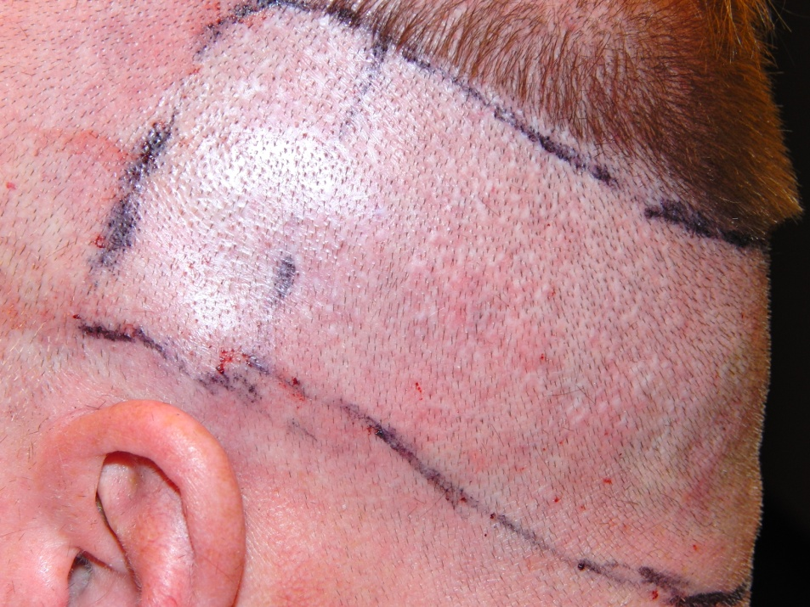
Graft Orientation
Superior or top
Superior or top
Inferior or Bottom
Inferior or Bottom
Observe the Angle of the Top Layer of Skin of the Graft to Determine Graft Orientation
Notes:
To better understand the approach angle and how it effects graft quality, you should first understand graft orientation. The graft orientation is based on the orientation in which it came out of the patient’s scalp. To know the superior vs inferior portions of the graft, first observe the angle of the top layer of skin of the graft. Next, look at the direction in which the hair grows out of the top of the graft. The hair direction will point towards the inferior portion of the scalp. Understanding graft orientation will now help you determine whether the approach angle is too high or too low.

Slide 16
Partial Transections - Obtuse Approach Angle
Transection will Occur at the Top of the Graft
Transection will Occur at the Top of the Graft
Superior
Approach Angle Too High
Inferior
Notes:
Now that we understand how to determine the graft orientation, now let’s determine what change to the angle parameter needs to be made in order to improve graft quality. First let’s discuss what you will see when the approach angle is obtuse, or too high.
If the approach angle is too high, you may see partial transections under the microscope. Examining the graft under the microscope, first determine the superior (top) and the inferior (bottom) of the graft discussed in the previous slide. If the partial transection is at the superior (top) portion of the graft, the approach angle may be too obtuse. The correction would be to lower the Angle parameter. Complete 1-2 harvests and check graft quality.

Slide 17
Partial Transection – Acute Approach Angle
Superior
Approach Angle Too Low
Inferior
Transection will Occur at the Bottom of the Graft
Transection will Occur at the Bottom of the Graft
Notes:
Next, let’s discuss what you will see when the approach angle is acute, or too low.
If the approach angle is too low, you may see partial transections under the microscope. Examining the graft under the microscope, first determine the superior (top) and the inferior (bottom) of the graft discussed in the previously. If the partial transection is at the inferior, or bottom, portion of the graft, the approach angle may be too acute. The correction would be to increase the Angle parameter. Complete 1-2 harvests and check graft quality.

Slide 18
Issue: Off Centered Hair
What Do You See?
The Hair is Off Center as Seen Here
Possible Causes:
Incorrect Approach Angle
Corrective Steps:
Examine Closely Under the Microscope to Determine Proper Adjustment of Angle
If Grafts are Fully Intact with No Transections, Do Not Adjust the Approach Angle
Continue to Monitor
Verify Punch Calibration
Improper Punch Calibration
Off Centered Hair
Notes:
Here, we see a hair that is not centered in the graft. You can see this when looking at the hair exiting from the top layer of skin. If there is no damage to the graft and it is fully intact, there is no need for any parameter adjustments. Continue to monitor graft quality. The punch calibration should be verified to ensure it is properly targeting the grafts.
If you do observe damage to the graft, check the angle as discussed previously and make the adjustments accordingly.

Slide 19
Issue: Miniaturized Hair
What Do You See?
Short, Miniaturized Hair
Possible Causes:
Patient Anatomy
Corrective Steps:
Do Not Discard - Vellus or Miniaturized Hair is Viable if All Pertinent Anatomy of the Follicle is in Place
Bulb/Root
Protective
Root Sheath
Notes:
Miniturized hair may sometimes be mistaken as a fully transected follicle, when in fact, it is a fully intact graft that is small or miniaturized that should not be mistakenly discarded.
When using the microscope, be sure to adjust setting for your eyes. It is vital that you have a clear image of the graft. You must be able to determine what you are looking at when examining the graft under the microscope. If you are not sure of your observation, do not discard. Put in a separate dish and ask the Dr. or an experienced hair technician to examine and determine if extracted harvests are viable.

Slide 20
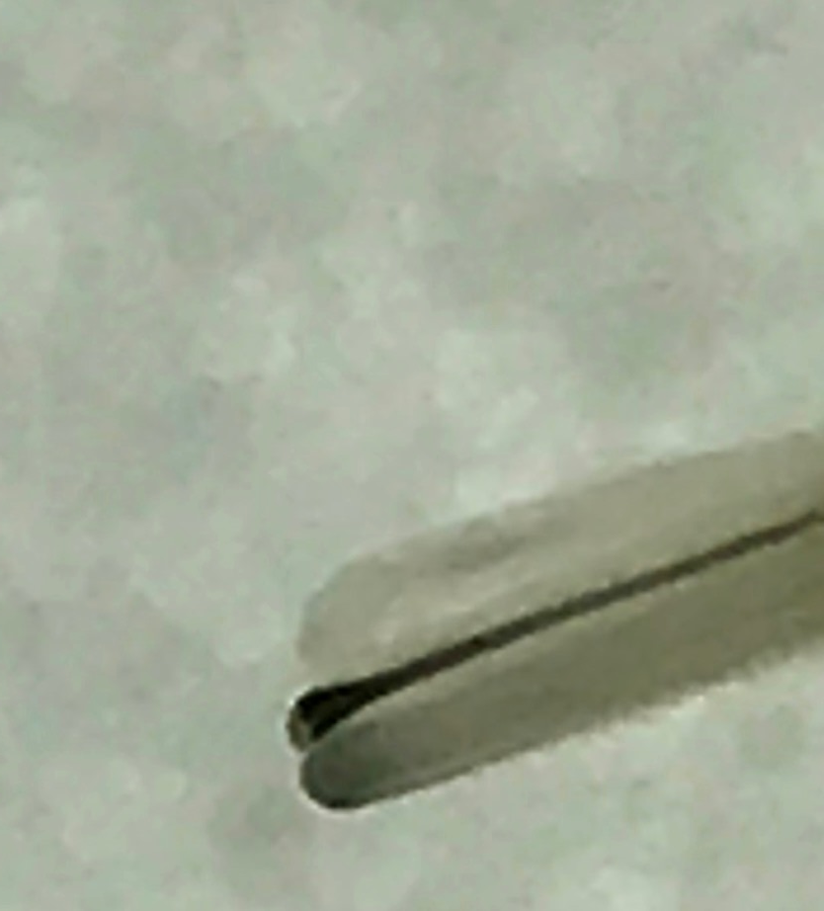
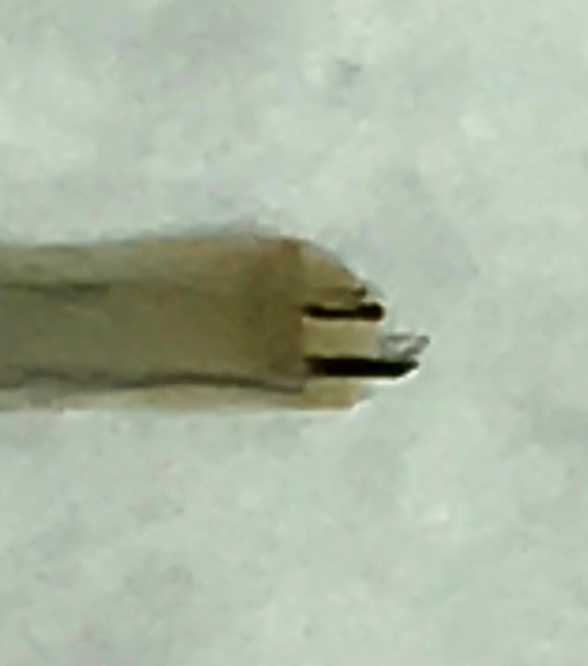
Issue: White/Grey Hair
What Do You See?
Grey, White or Translucent Hair
Possible Causes:
Patient Anatomy
Corrective Steps:
Do Not Discard - This Hair is Viable if All Pertinent Anatomy of the Follicle is in Place
Observe the
White/Grey
Hair From
Top to Bottom
of Harvest
White Hair at Circular Top
(Enlarged Image)
White/Grey Bulb
Translucent
(Enlarged Image)
Notes:
Here is another example of something commonly seen under the microscope that is incorrectly identified if the microscope is not adjusted properly. When examining white/grey hair under the microscope, use the hair shaft with color as a guide. The root is transparent in appearance. Rotate hair slowly and look for the translucent bulb. Every harvest counts for a good yield. Here, what appears to be a 2 hair graft at first glance, is actually a 3 hair graft! If unsure of what your looking for ask the Dr. or an experienced hair technician to help guide you.

Slide 21
#ThankYouVEROMuch
Notes:
Thank you for joining the Venus Academy course, under the microscope. We wish you much success in your Hair Restoration Practice!
For your reference, this training is available via Mindflash at anytime. Contact your Clinical Training Manager if you have any questions.

