Slide 1
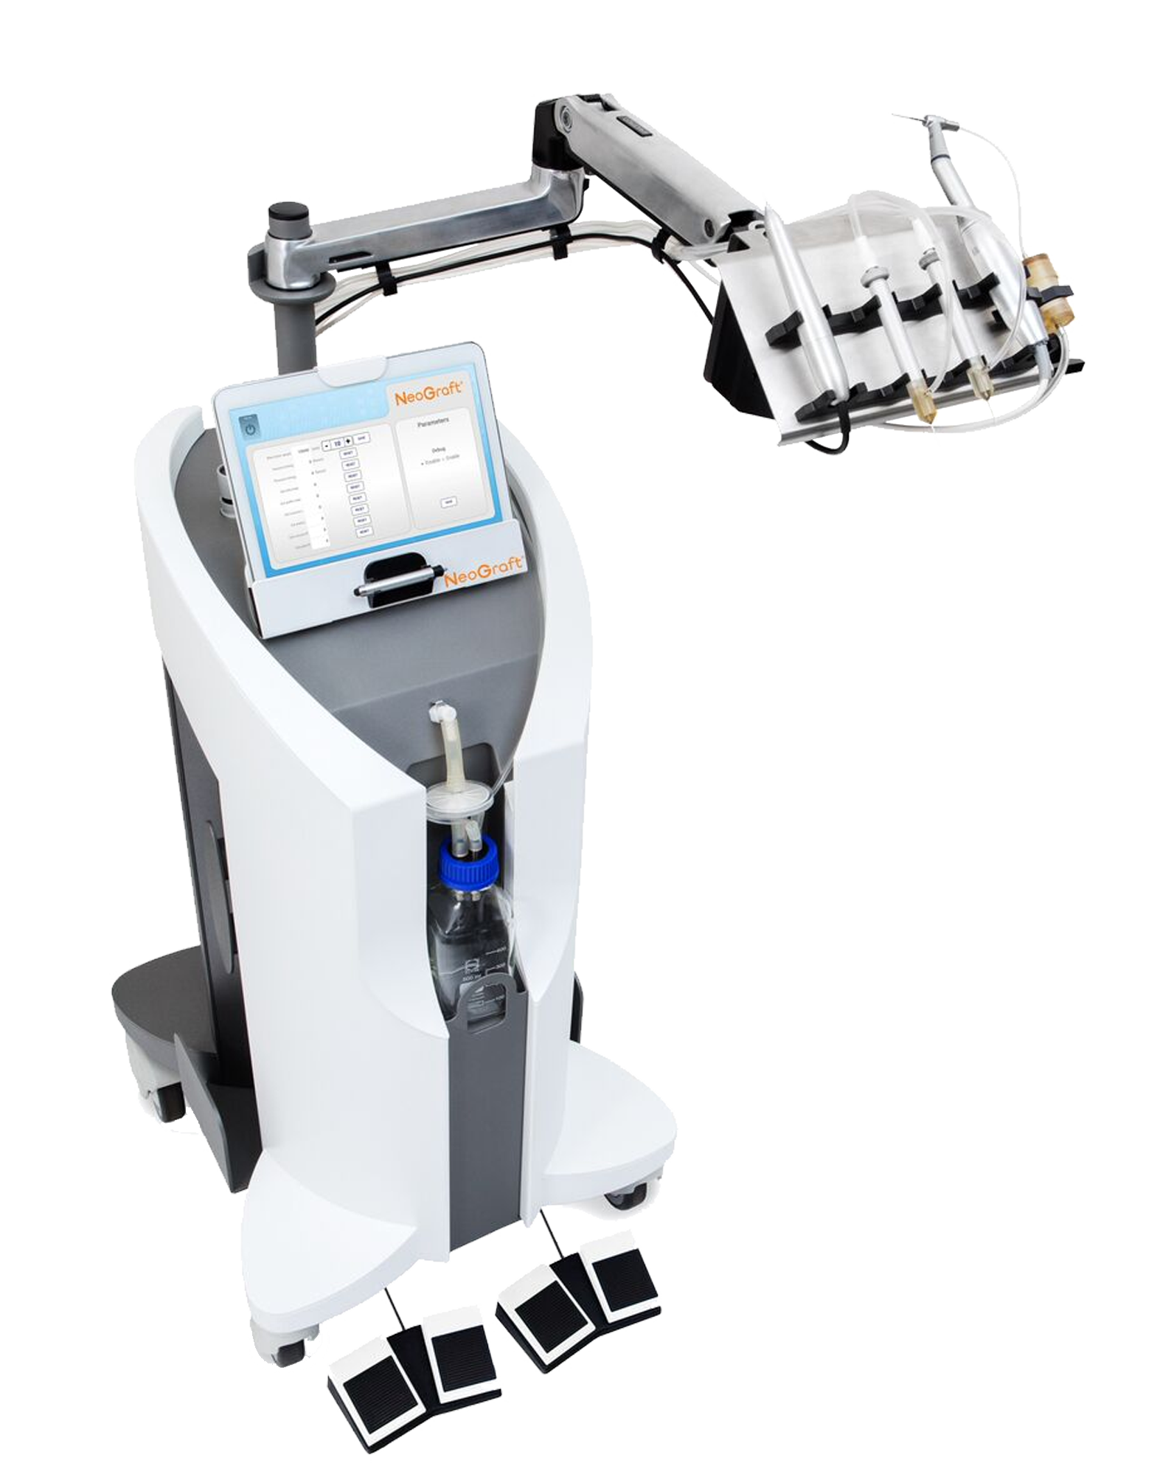
A True Partnership

Slide 2
The Leader in Hair Transplant Technology
LEADING-EDGE TECHNOLOGY FOR HAIR RESTORATION
NeoGraft 2.0 is the latest leader in hair transplant technology. We combined next-generation surgical techniques with decades of data, and designed NeoGraft 2.0 to be more than a device. It is engineered to make us partners.
MINIMALLY INVASIVE & LITTLE TO NO DISCOMFORT
NeoGraft is a minimally invasive procedure with no sutures or staples, resulting in a natural-looking hairline (no linear scar). With no scalpel involved, there is little to no discomfort during and after the procedure.
QUICK RECOVERY TIME & SUPERIOR RESULTS
The recovery time is quick, allowing patients to resume normal activity after only a few days. Over the course of a few months, hair will continue to grow normally with a healthy and natural-looking outcome.
Notes:
and

Slide 3
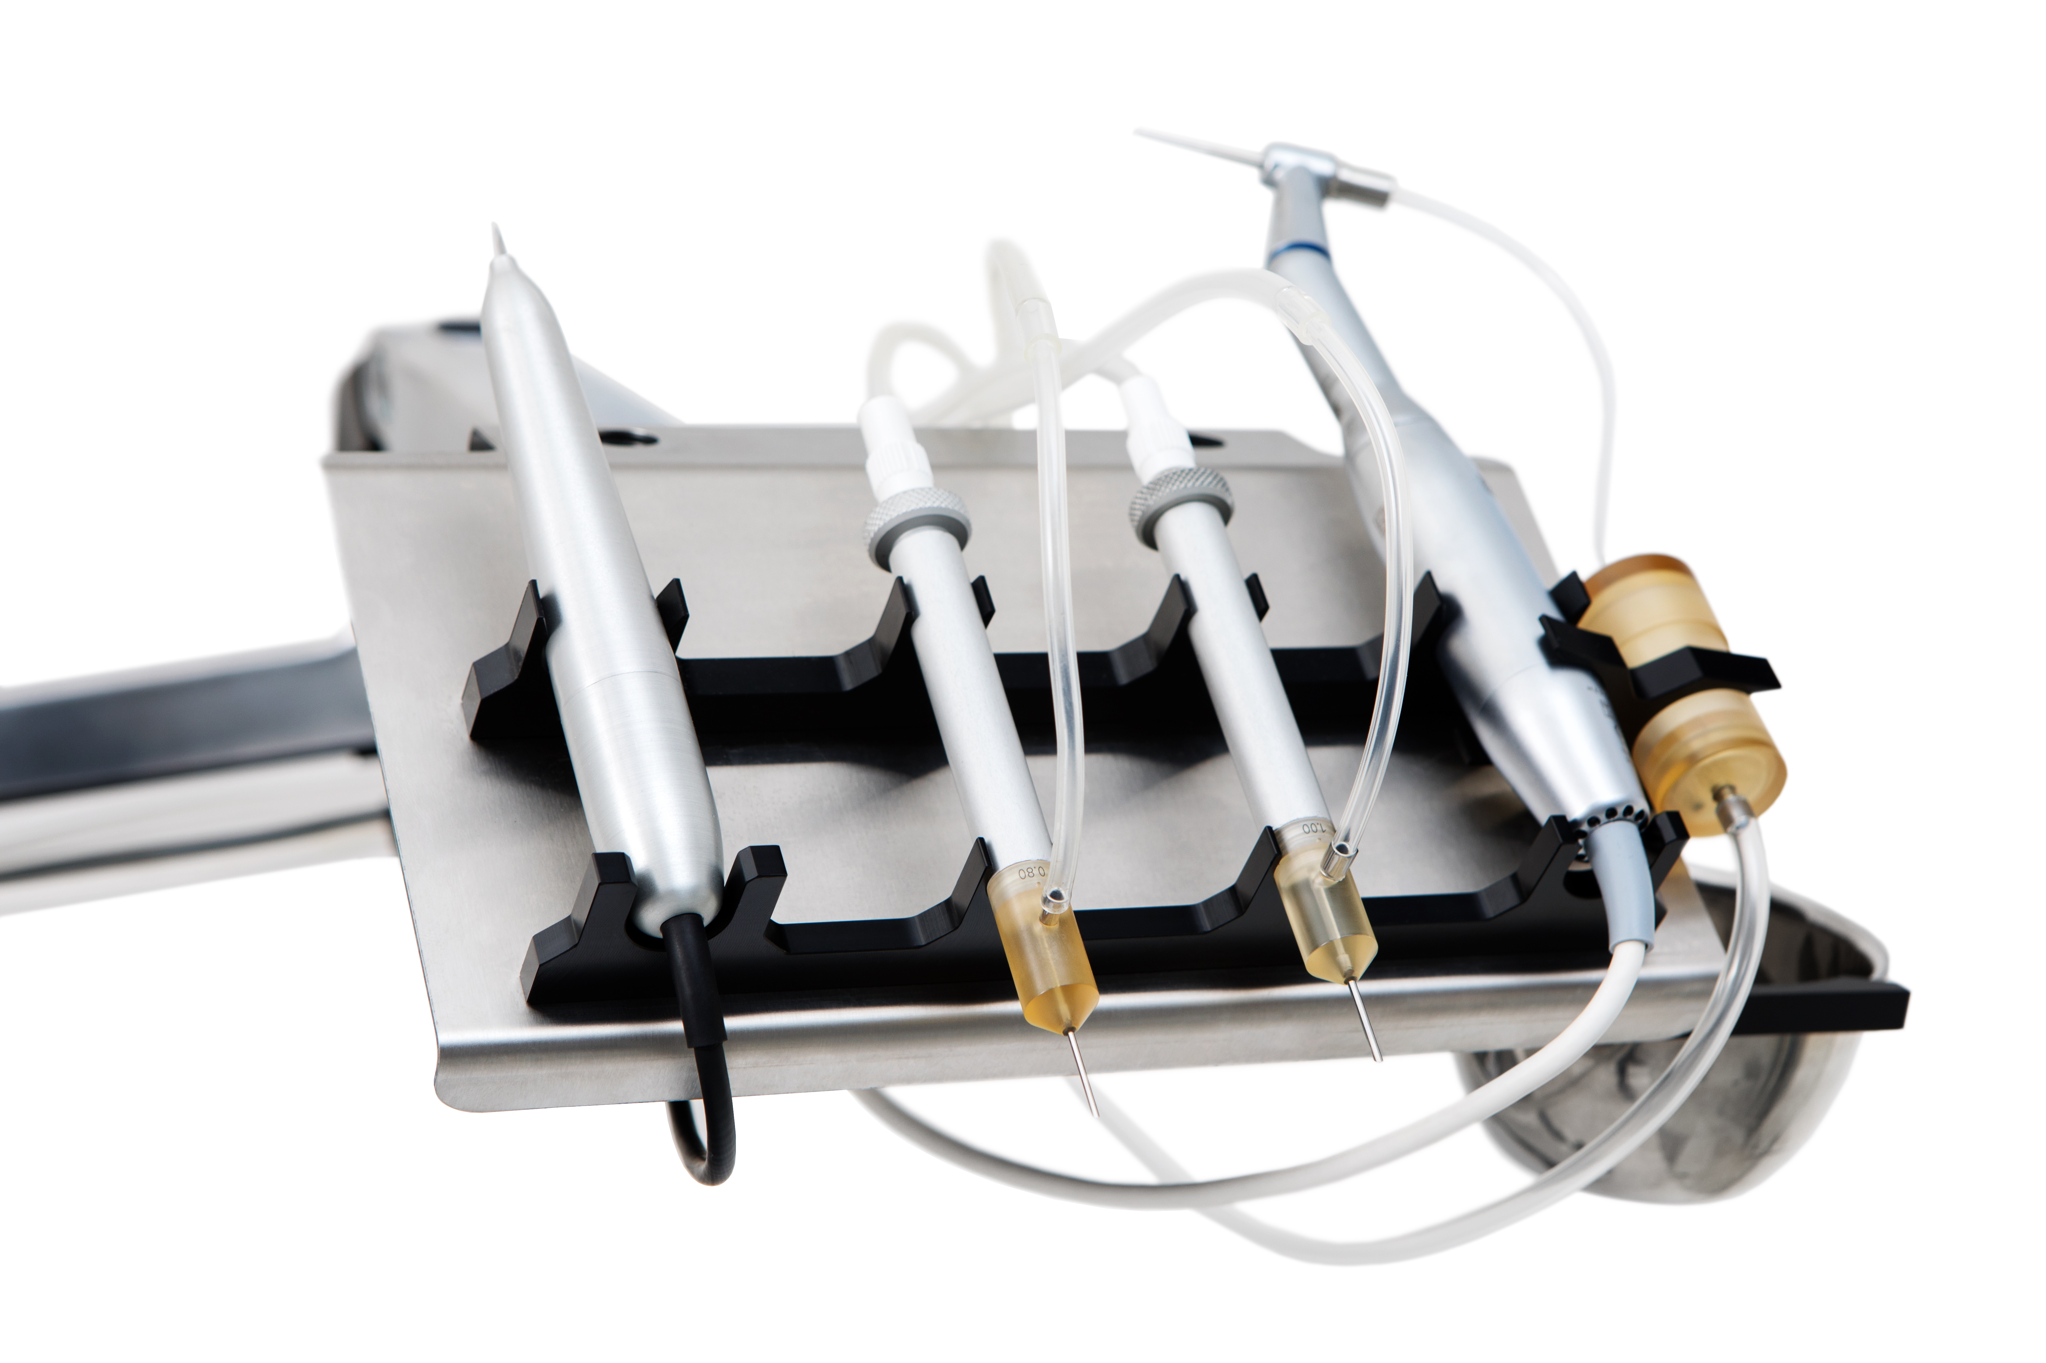
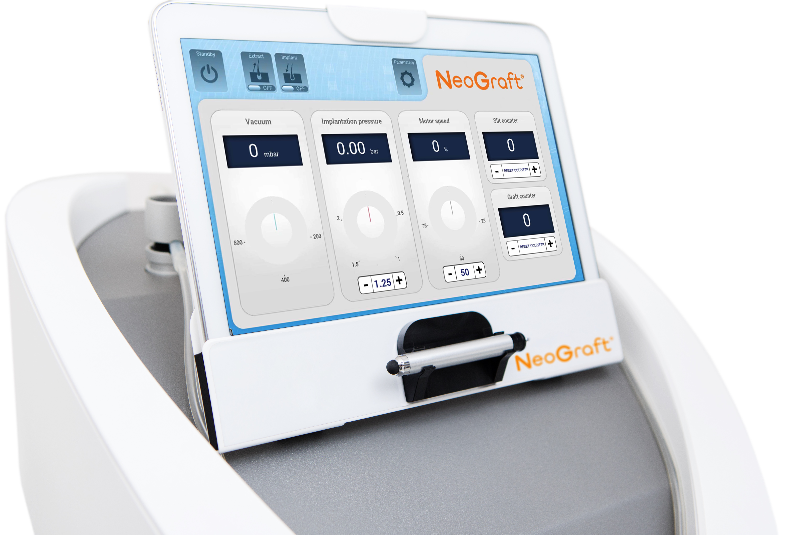
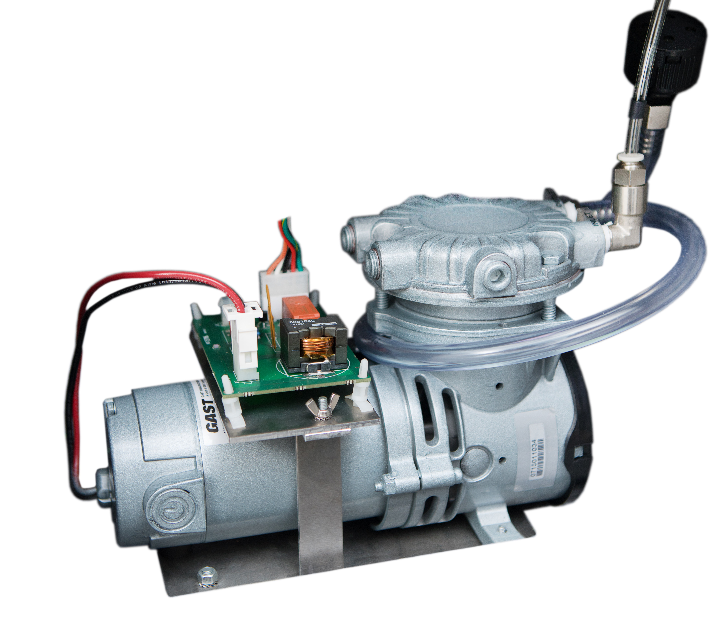
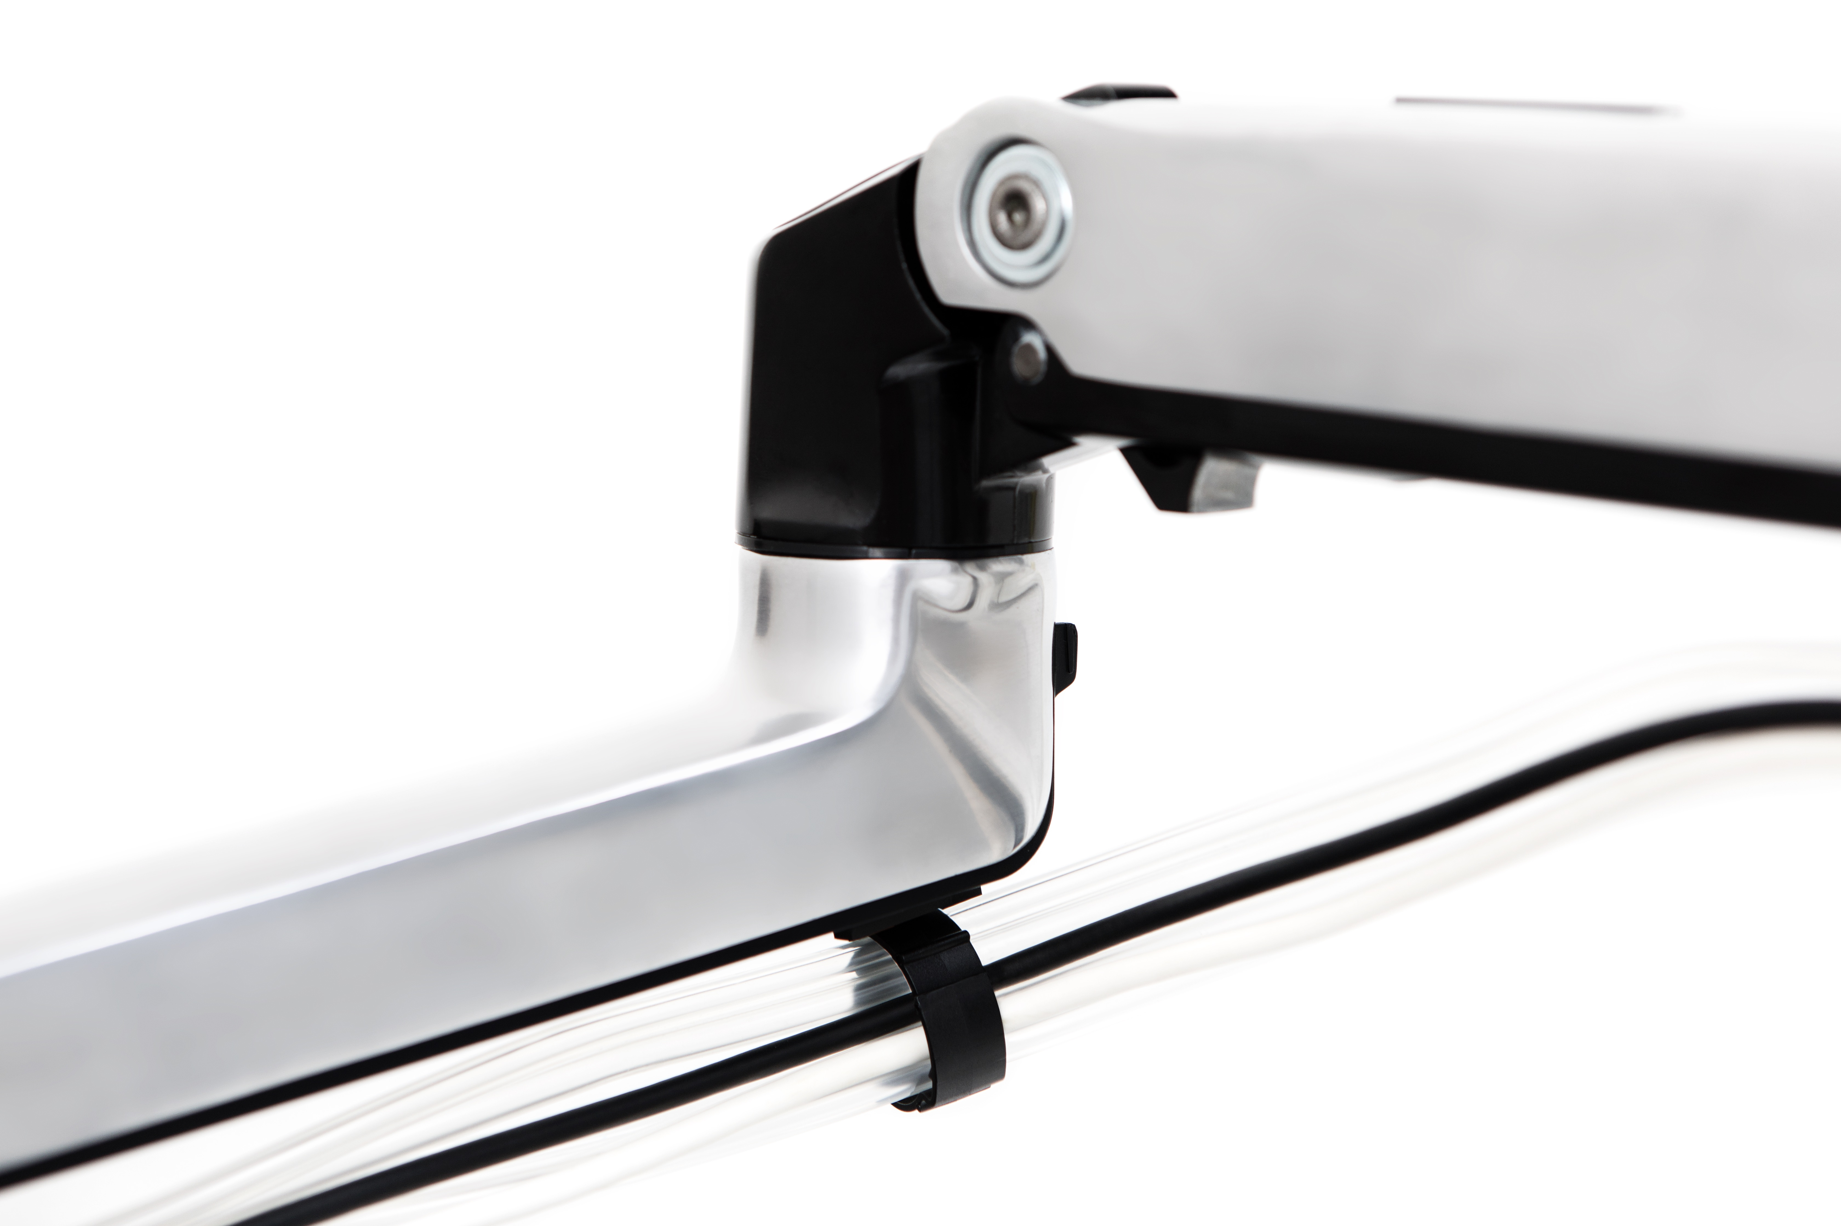
Advanced Technology
Updated Implant & Extraction Tools
Introduction of recipient site creation hand piece that delivers more standardized implants.
Hand tools are completely autoclavable.
Tools and tubing are neatly organized.
Touchscreen Interface
Wireless connectivity enables remote access for diagnostics, maintenance, automatic upgrades and procedural data.
Real-time extract and implant graft counts.
Pneumatic Motor
Piston-driven pneumatic motor that delivers precise pressure control for both extraction and implantation.
More efficient, quieter and more consistent suction.
Double-Jointed Arm & Workstation
Increases efficiency of the operating room.
Allows for storage in a less than 5-sq.-foot total area.

Slide 4

Technician Support
CERTIFIED & INSURED
ONGOING EDUCATIONAL TRAINING
RELIABLE
PATIENT SATISFACTION
EXTENSION OF YOUR STAFF

Slide 5
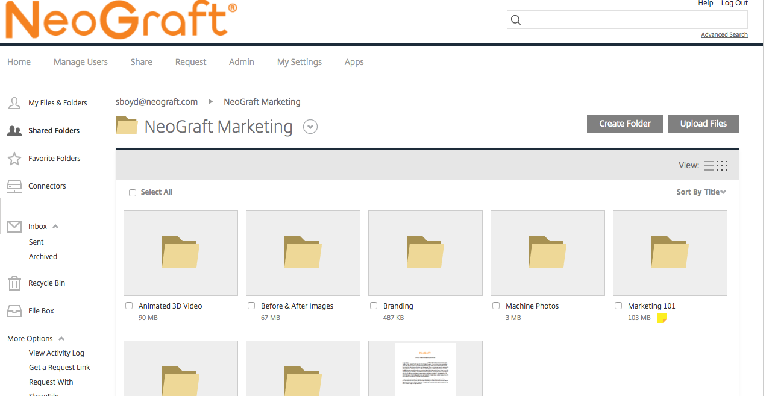
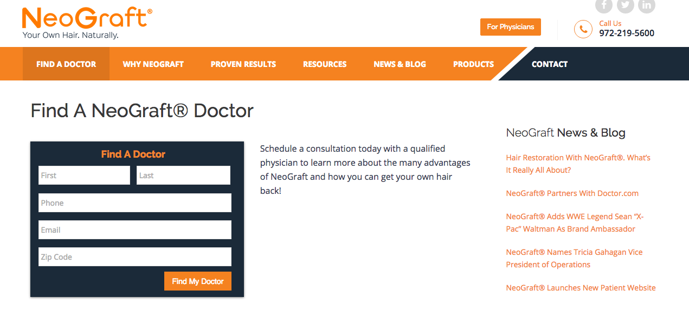
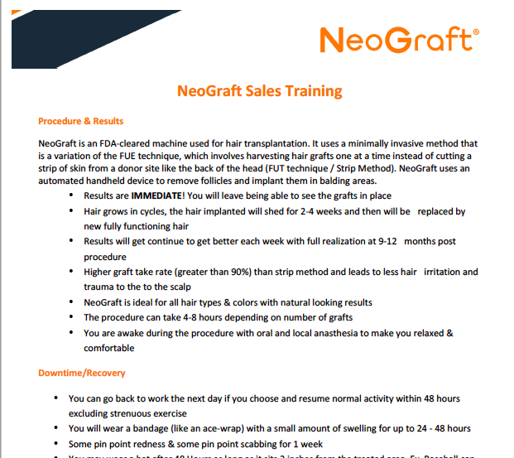


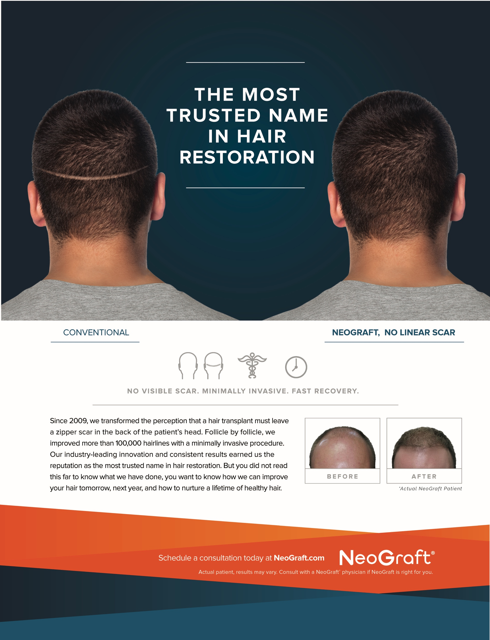
Hands-on Corporate Staff & True Partnership
Sharefile – Marketing Assets
Find A Doctor – NeoGraft.com
ONGOING ACCOUNT MGMT. SUPPORT
DIRECT PATIENT REFERRALS
COLLATERAL & ASSETS PROVIDED
CO-OP PROGRAM
NATIONAL EXPOSURE
Ongoing Support
Radio Ads
Print Ads
Sales Consultation
Training
Starter Kit

